Slide 1
SITE-SEEING
Zeus Zhou
WebDev25

Slide 2
SITE-SEEING is inspired by “The Useless Web”, it has seven categories and each will lead the user into a random website from the corresponding area
It aims to provide a surprising yet personalized browsing experience based on the user's current mood or state

Slide 3
Some coding highlights

Slide 4
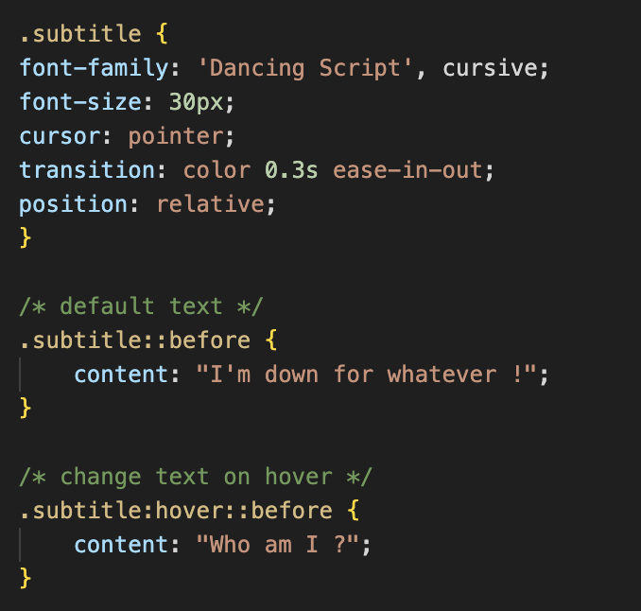
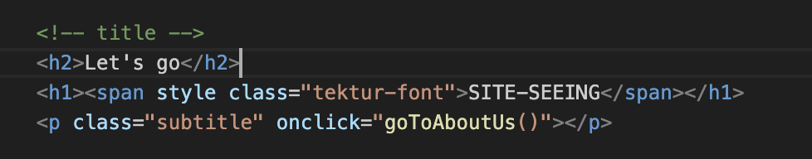
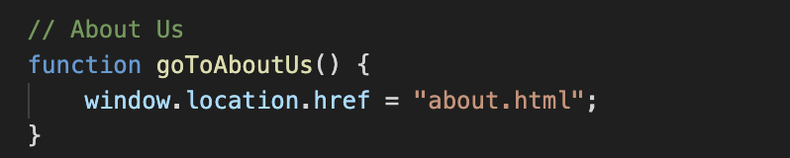
The subtitle becomes a link to the about/contact page on hover

Slide 5
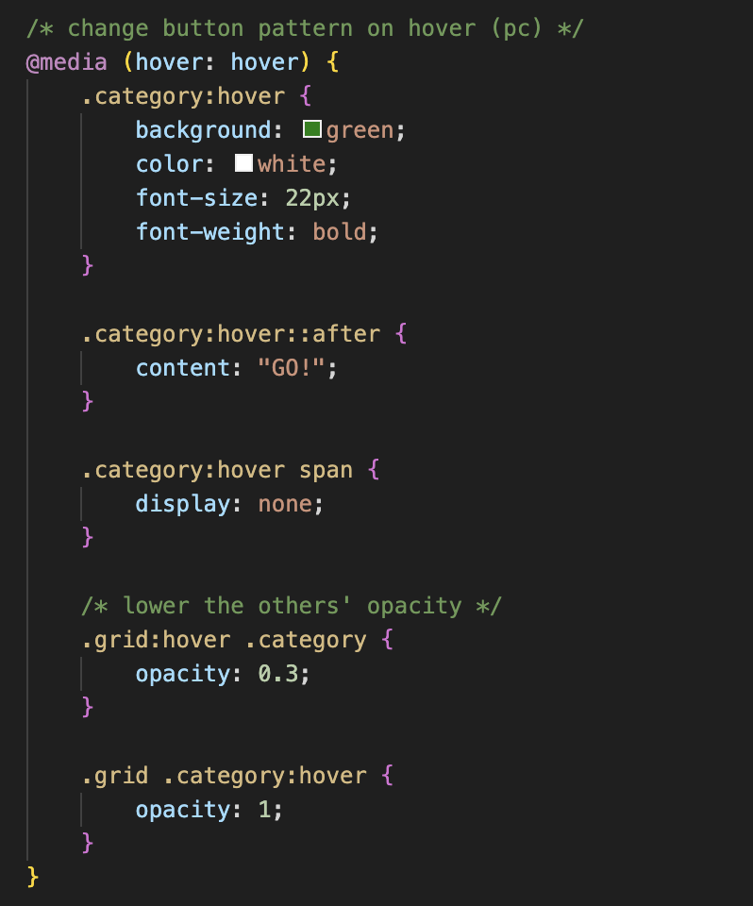
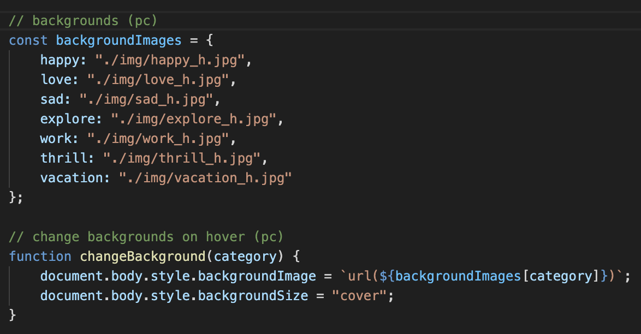
On PC, hover on the buttons changes the pattern of the button and the background

Slide 6
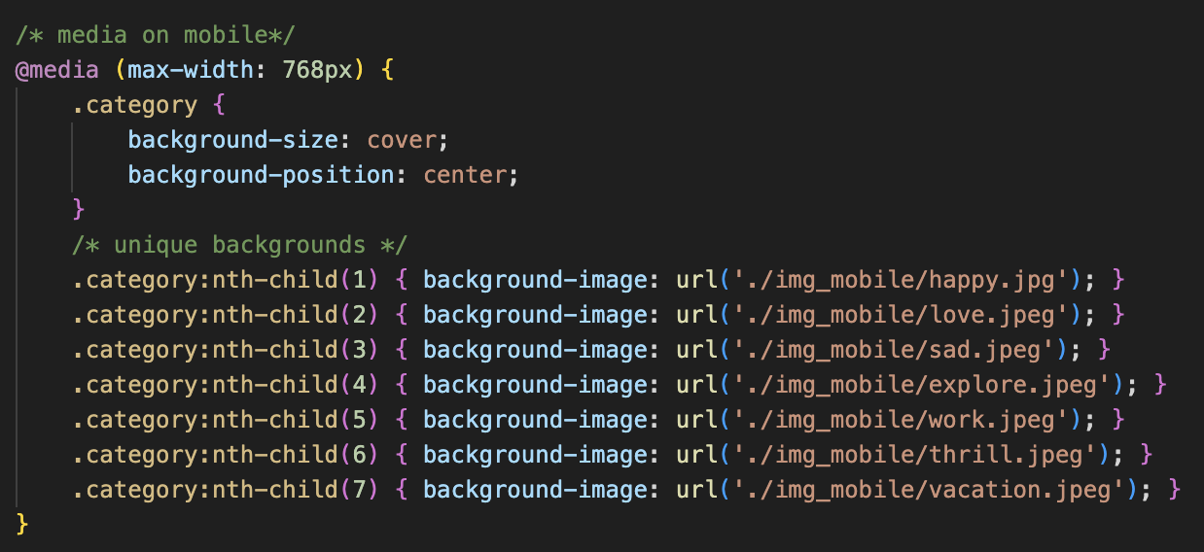
On mobile, images are in the buttons directly (no hover)

Slide 7
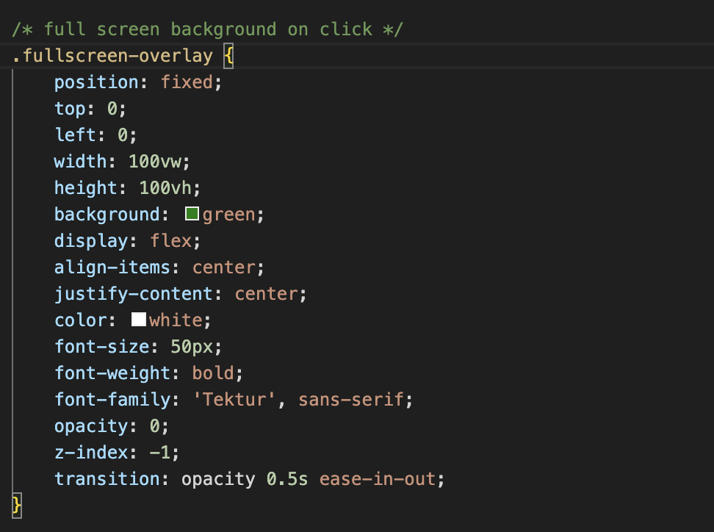
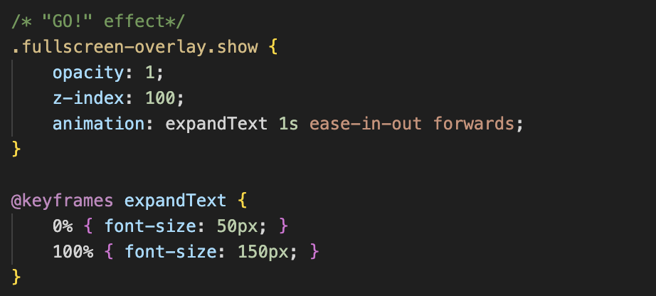
On mobile, full screen effect on click

Slide 8
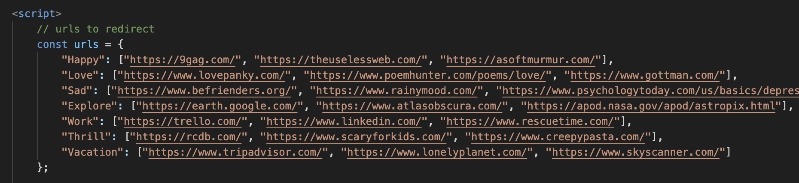
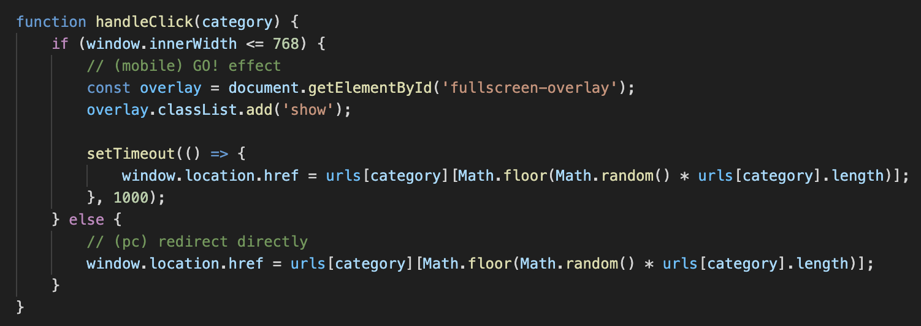
Random access to websites on click

